Slide 1
Dimensionality Reduction

Slide 2
Dimensionality Reduction
Dimensionality reduction is the process of reducing the number of features (or variables) in a dataset while retaining as much important information as possible.
It helps simplify data, speed up processing, and make patterns easier to understand.

Slide 3
Example
ID | Age | Height | Weight | Hours of Training/Week | Daily Calorie Intake | Sports Grade
1 | 14 | 160 | 50 | 5 | 2000 | 85
2 | 15 | 165 | 55 | 8 | 2200 | 90
3 | 14 | 170 | 60 | 6 | 2100 | 88
BMI = Weight (kg) / (Height (m)^2)
Fitness Index = (Hours of Training × 2) + (Daily Calorie Intake ÷ 1000)
ID | Age | BMI | Fitness Index | Sports Grade
1 | 14 | 19.5 | 9.0 | 85
2 | 15 | 20.2 | 10.6 | 90
3 | 14 | 20.8 | 9.2 | 88

Slide 4
Advantages of Dimensionality Reduction
1. Improved Performance of Machine Learning Models:
Reducing irrelevant or redundant features can lead to faster training and inference times.
Prevents the "curse of dimensionality," where too many features cause models to overfit or perform poorly.
2. Simplified Visualization:
High-dimensional data (e.g., 100+ features) is hard to visualize.
Dimensionality reduction (e.g., PCA, t-SNE) helps project data into 2D or 3D, making patterns and clusters easier to understand.
3. Noise Reduction:
It helps remove irrelevant or noisy features, improving data quality and model accuracy.
4. Reduced Storage and Computation Costs:
By lowering the number of features, datasets become smaller, requiring less memory and computational resources.
5. Avoid Overfitting:
Fewer features reduce the risk of overfitting, as the model focuses on the most meaningful variables.
6. Feature Engineering:
Creates new, meaningful features (e.g., principal components in PCA) that capture the essence of the original data.

Slide 5
Dimensionality Reduction methods
Dimensionality Reduction
Principal Component Analysis (PCA)
Linear Discriminant Analysis (LDA)
t-Distributed Stochastic Neighbor Embedding

Slide 6
1. Principal Component Analysis (PCA):
Purpose: Reduces dimensions by transforming the original features into new, uncorrelated features called principal components.
How it Works:
Identifies the directions (principal components) that capture the most variance in the data.
Projects the data onto these components, keeping only the top ones to reduce dimensions.
Best For: Numerical data with high correlations between features.
Example Use: Image compression, feature selection in machine learning.

Slide 7
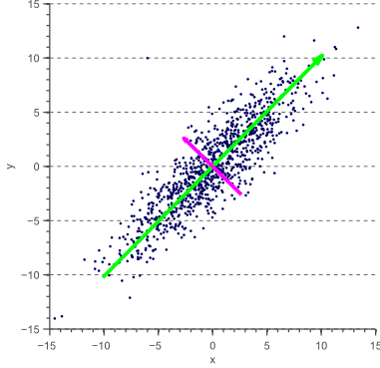

Slide 8
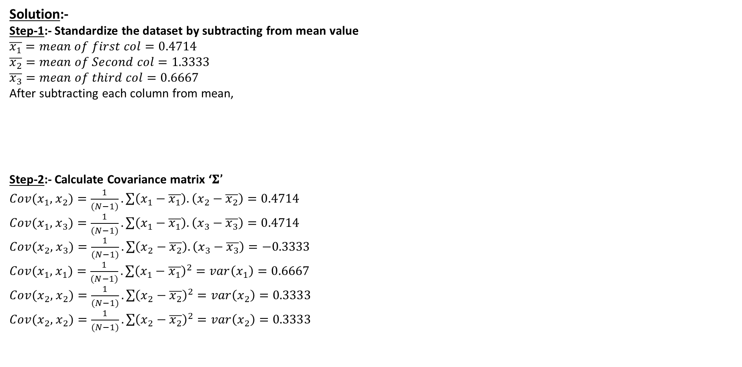
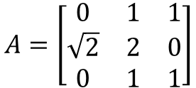
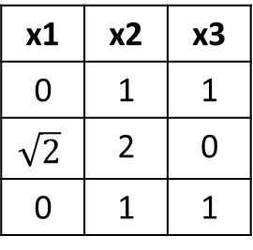
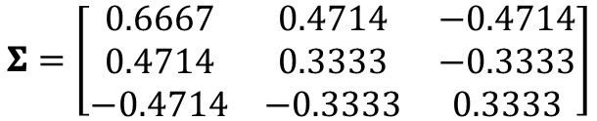
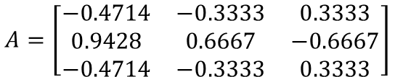
Example: For the Given Data Matrix find Principal component using PCA
$$A=\left[\begin{matrix}0 & 1 & 1 \\ \sqrt{2} & 2 & 0 \\ 0 & 1 & 1\end{matrix}\right]$$
Solution:-
Step-1:- Standardize the dataset by subtracting from mean value
$$\overline{x_{1}}=mean of first col=0.4714$$
$$\overline{x_{2}}=mean of Second col=1.3333$$
$$\overline{x_{3}}=mean of third col=0.6667$$
After subtracting each column from mean,
Step-2:- Calculate Covariance matrix ‘𝚺’
$Cov(x_{1},$ $x_{2})=\frac{1}{(N−1)}.\sum{\left(x_{1}−\overline{x_{1}}\right).\left(x_{2}−\overline{x_{2}}\right)}=0.4714$
$Cov(x_{1},$ $x_{3})=\frac{1}{(N−1)}.\sum{\left(x_{1}−\overline{x_{1}}\right).\left(x_{3}−\overline{x_{3}}\right)}=0.4714$
$Cov(x_{2},$ $x_{3})=\frac{1}{(N−1)}.\sum{\left(x_{2}−\overline{x_{2}}\right).\left(x_{3}−\overline{x_{3}}\right)}=−0.3333$
$Cov(x_{1},$ $x_{1})=\frac{1}{(N−1)}.\sum{{\left(x_{1}−\overline{x_{1}}\right)}^{2}}=var\left(x_{1}\right)=0.6667$
$Cov(x_{2},$ $x_{2})=\frac{1}{(N−1)}.\sum{{\left(x_{2}−\overline{x_{2}}\right)}^{2}}=var\left(x_{2}\right)=0.3333$
$Cov(x_{2},$ $x_{2})=\frac{1}{(N−1)}.\sum{{\left(x_{2}−\overline{x_{2}}\right)}^{2}}=var\left(x_{2}\right)=0.3333$
x1 | x2 | x3
0 | 1 | 1
$$\sqrt{2}$$ | 2 | 0
0 | 1 | 1
$$A=\left[\begin{matrix}−0.4714 & −0.3333 & 0.3333 \\ 0.9428 & 0.6667 & −0.6667 \\ −0.4714 & −0.3333 & 0.3333\end{matrix}\right]$$
$$\text{Σ}=\left[\begin{matrix}0.6667 & 0.4714 & −0.4714 \\ 0.4714 & 0.3333 & −0.3333 \\ −0.4714 & −0.3333 & 0.3333\end{matrix}\right]$$

Slide 9
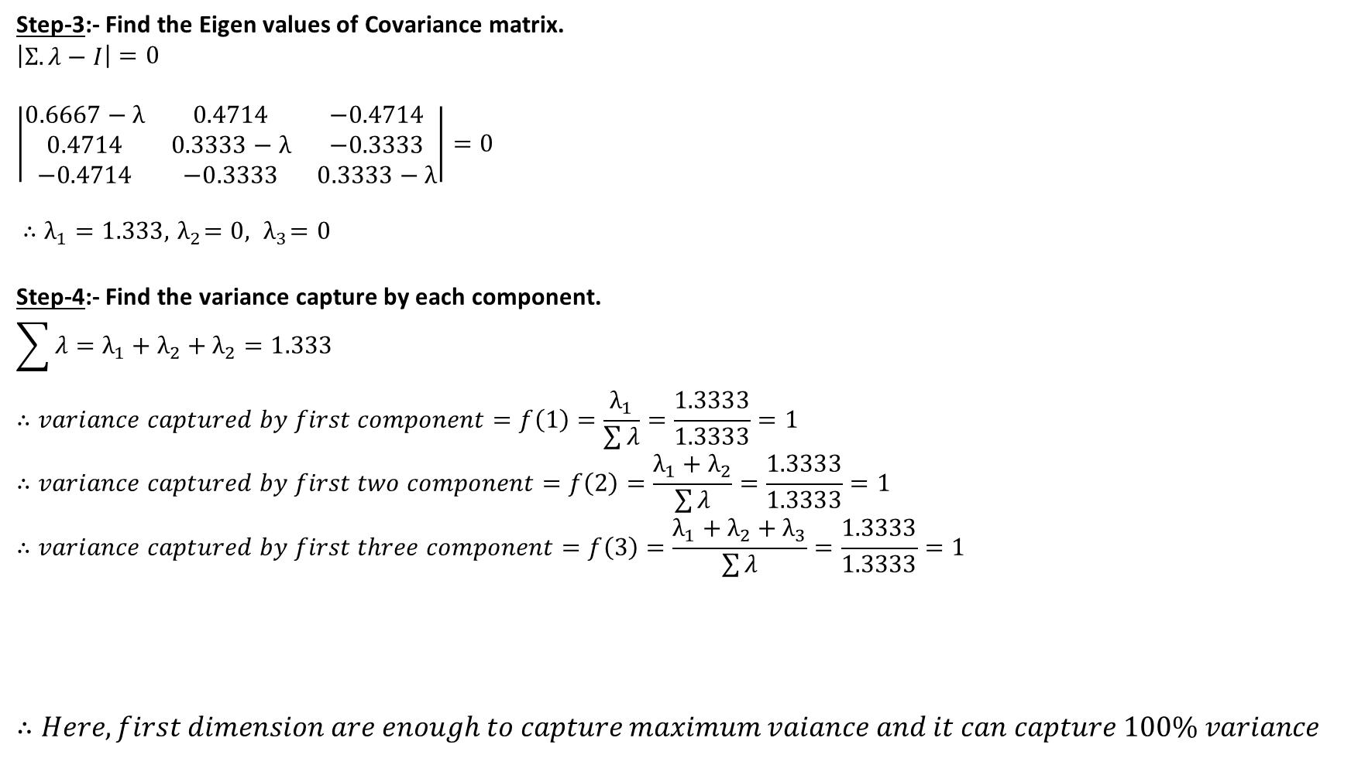
Step-3:- Find the Eigen values of Covariance matrix.
$$\left|\begin{matrix}\text{Σ}.λ−I\end{matrix}\right|=0$$
$$\left|\begin{matrix}0.6667−λ & 0.4714 & −0.4714 \\ 0.4714 & 0.3333−λ & −0.3333 \\ −0.4714 & −0.3333 & 0.3333−λ\end{matrix}\right|=0$$
$∴λ_{1}=1.333,{ λ}_{2}=0,{ λ}_{3}=0$
Step-4:- Find the variance capture by each component.
$$\sum{λ=λ_{1}+λ_{2}+λ_{2}=1.333}$$
$$∴variance captured by first component=f\left(1\right)=\frac{λ_{1}}{\sum{λ}}=\frac{1.3333}{1.3333}=1$$
$$∴variance captured by first two component=f\left(2\right)=\frac{λ_{1}+λ_{2}}{\sum{λ}}=\frac{1.3333}{1.3333}=1$$
$$∴variance captured by first three component=f\left(3\right)=\frac{λ_{1}+λ_{2}+λ_{3}}{\sum{λ}}=\frac{1.3333}{1.3333}=1$$
$$∴Here, first dimension are enough to capture maximum vaiance and it can capture 100\% variance$$
r | 1 | 2 | 3
F(r) | 1 | 1 | 1

Slide 10
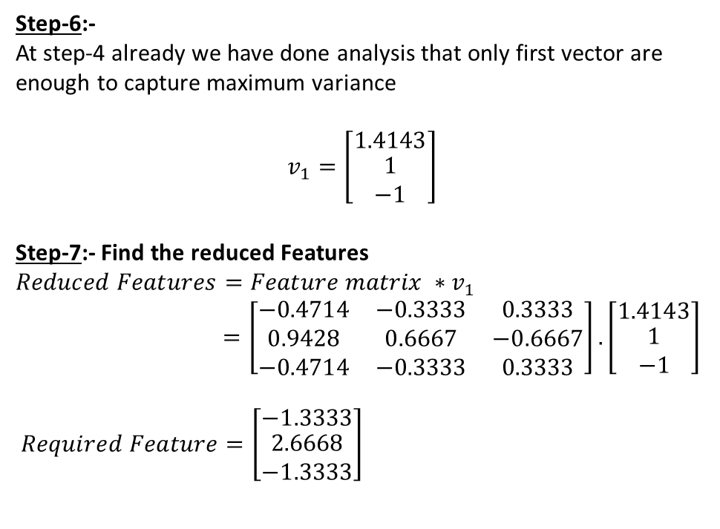
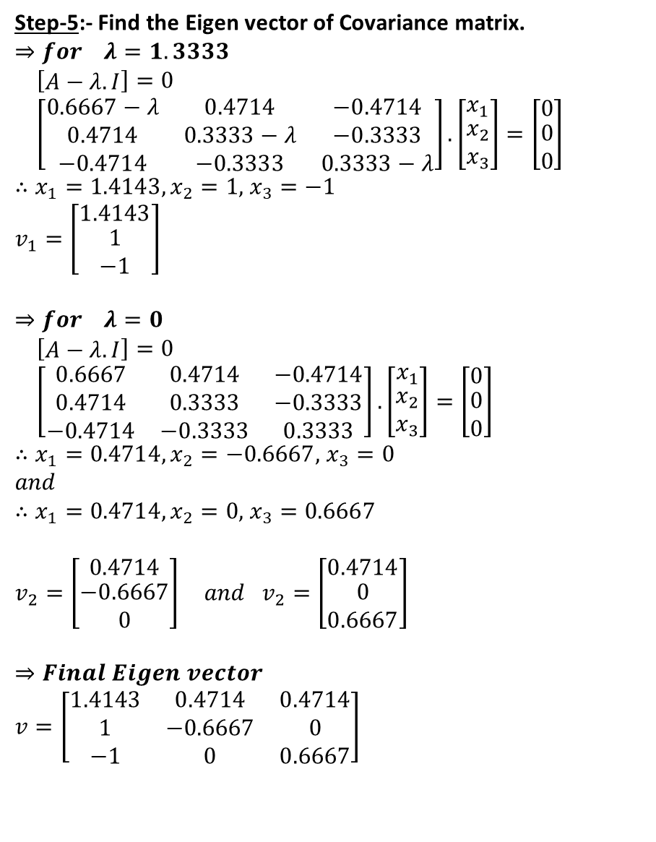
Step-5:- Find the Eigen vector of Covariance matrix.
$$⇒for λ=1.3333$$
$\left[\begin{matrix}A−λ.I\end{matrix}\right]=0$
$\left[\begin{matrix}0.6667−λ & 0.4714 & −0.4714 \\ 0.4714 & 0.3333−λ & −0.3333 \\ −0.4714 & −0.3333 & 0.3333−λ\end{matrix}\right].\left[\begin{matrix}x_{1} \\ \begin{aligned}x_{2} \\ x_{3}\end{aligned}\end{matrix}\right]=\left[\begin{matrix}0 \\ \begin{aligned}0 \\ 0\end{aligned}\end{matrix}\right]$
$∴x_{1}=1.4143,x_{2}=1,$ $x_{3}=−1$
$$v_{1}=\left[\begin{matrix}1.4143 \\ \begin{aligned}1 \\ −1\end{aligned}\end{matrix}\right]$$
$$⇒for λ=0$$
$\left[\begin{matrix}A−λ.I\end{matrix}\right]=0$
$\left[\begin{matrix}0.6667 & 0.4714 & −0.4714 \\ 0.4714 & 0.3333 & −0.3333 \\ −0.4714 & −0.3333 & 0.3333\end{matrix}\right].\left[\begin{matrix}x_{1} \\ \begin{aligned}x_{2} \\ x_{3}\end{aligned}\end{matrix}\right]=\left[\begin{matrix}0 \\ \begin{aligned}0 \\ 0\end{aligned}\end{matrix}\right]$
$∴x_{1}=0.4714,x_{2}=−0.6667,$ $x_{3}=0$
$$and$$
$∴x_{1}=0.4714,x_{2}=0,$ $x_{3}=0.6667$
$$v_{2}=\left[\begin{matrix}0.4714 \\ \begin{aligned}−0.6667 \\ 0\end{aligned}\end{matrix}\right] and{ v}_{2}=\left[\begin{matrix}0.4714 \\ \begin{aligned}0 \\ 0.6667\end{aligned}\end{matrix}\right]$$
$$⇒Final Eigen vector$$
$$v=\left[\begin{matrix}1.4143 & 0.4714 & 0.4714 \\ 1 & −0.6667 & 0 \\ −1 & 0 & 0.6667\end{matrix}\right]$$
Step-6:-
At step-4 already we have done analysis that only first vector are enough to capture maximum variance
$$v_{1}=\left[\begin{matrix}1.4143 \\ \begin{aligned}1 \\ −1\end{aligned}\end{matrix}\right]$$
Step-7:- Find the reduced Features
$$Reduced Features=Feature matrix ∗v_{1}$$
$=\left[\begin{matrix}−0.4714 & −0.3333 & 0.3333 \\ 0.9428 & 0.6667 & −0.6667 \\ −0.4714 & −0.3333 & 0.3333\end{matrix}\right].\left[\begin{matrix}1.4143 \\ \begin{aligned}1 \\ −1\end{aligned}\end{matrix}\right]$
$$Required Feature=\left[\begin{matrix}−1.3333 \\ \begin{aligned}2.6668 \\ −1.3333\end{aligned}\end{matrix}\right]$$

Slide 11
2. Linear Discriminant Analysis (LDA):
Purpose: Reduces dimensions while maximizing the separation between classes.
How it Works:
Finds a new feature space that maximizes the distance between class means and minimizes variance within each class.
Works in a supervised setting (requires labeled data).
Best For: Classification problems where dimensionality reduction improves class separability.
Example Use: Facial recognition, text classification.

Slide 12
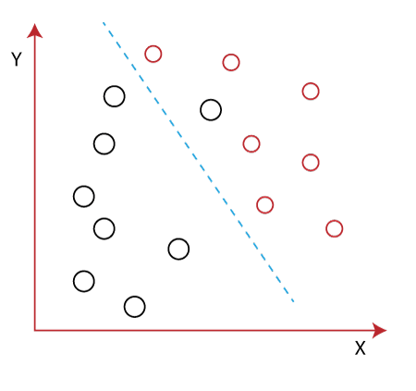

Slide 13
3. t-Distributed Stochastic Neighbor Embedding (t-SNE):
Purpose: Projects high-dimensional data into a lower-dimensional space (often 2D or 3D) while preserving the local structure of data.
How it Works:
Maps similar data points close to each other and dissimilar points far apart.
Uses probabilistic methods to model relationships between points in high and low dimensions.
Best For: Visualization of high-dimensional data.
Example Use: Exploring clusters in datasets like gene expression or customer segmentation

Slide 14
MNIST dataset
It consists of 70,000 grayscale images of handwritten digits (0-9).
Image Size: Each image is a 28x28 pixel grid.
Labels: Each image corresponds to a digit (0 to 9).
Pixel values range from 0 (black) to 255 (white).
Flattened for models into vectors of 784 (28x28) features.

Slide 15
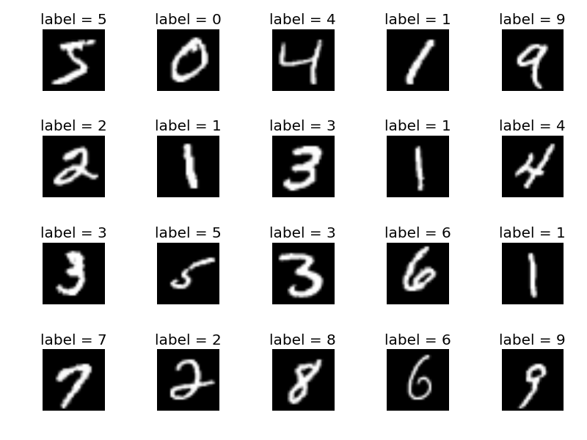

Slide 16
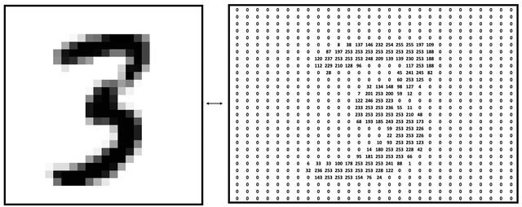
[0, 0, 0, ..., 0, 38, 137, 146, 1325, 234, ..., 0, 0, 0, 143, 253, 253,154,76,24 ..., 0, 0, 0, ...]

